Slide 1


Inequality, Graph
Noshin Nawar
Instructor, Phoenix Admission Care

Slide 2
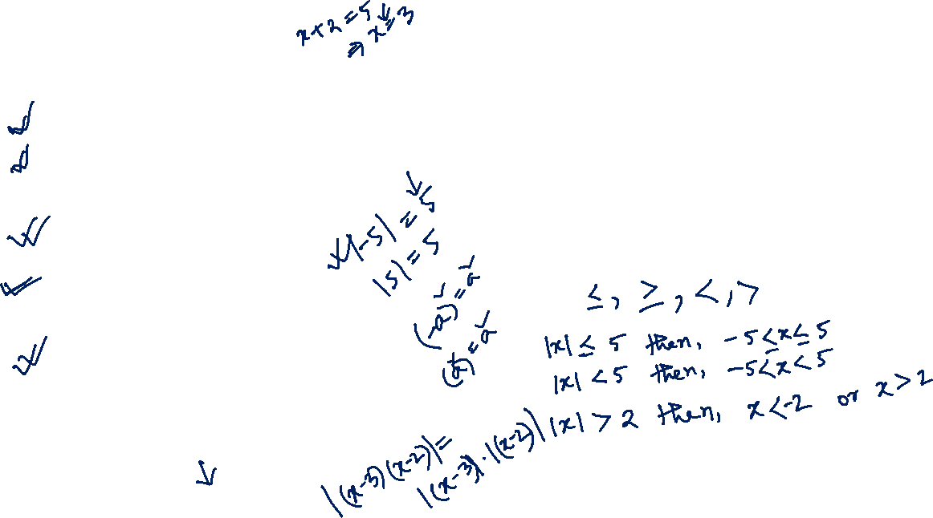
Inequality
• If | x | ≤ a, then –a ≤ x ≤ a
• If | x | ≥ a, then x ≤ –a or x ≥ a
• If | a | = 0, then a = 0
• If a ∈ R, then | a | ≥ 0
• If a ∈ R, then | a | ≥ a
• If a ∈ R, then | a | ≥ –a
• If a ∈ R, then | –a | = | a |
• If a ∈ R, then | a |² = a² or | a | = $\sqrt{a^{2}}$
• If a, b ∈ R, then | ab | = | a | | b |
• If a, b ∈ R, then | ab | = | a | | b |
• | a + b | ≤ | a | + | b |
• | a – b | ≤ | a | + | b |
• | a – b | ≥ | a | – | b |

Slide 3
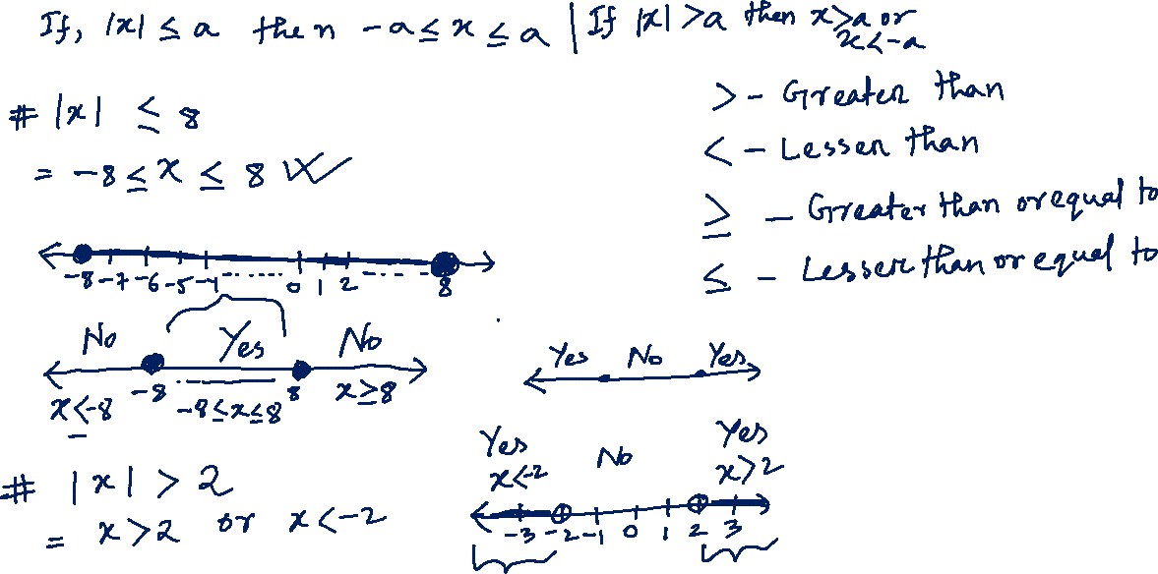

Slide 4
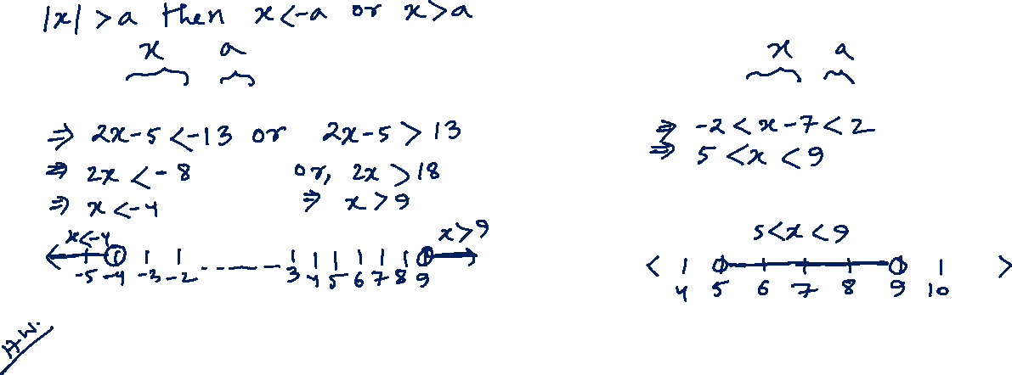
1. Solve | 2x – 5 | > 13
2. Solve | x – 7 | < 2
3. Solve | 2x – 5 | ≤ 13

Slide 5
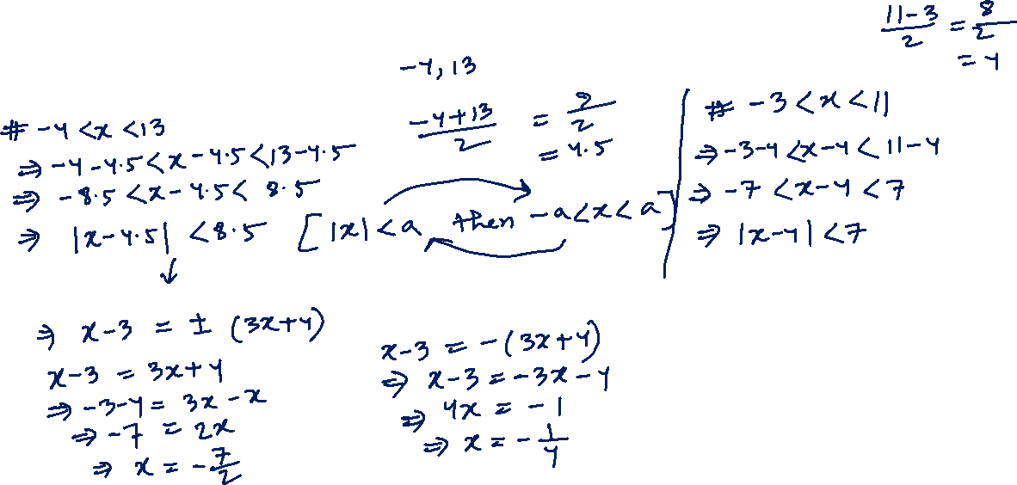
1. Express the following equations by absolute sign:
• -4 < x < 13
• -3 < x < 11
2. Solve | x – 3 | = | 3x + 4 |

Slide 6

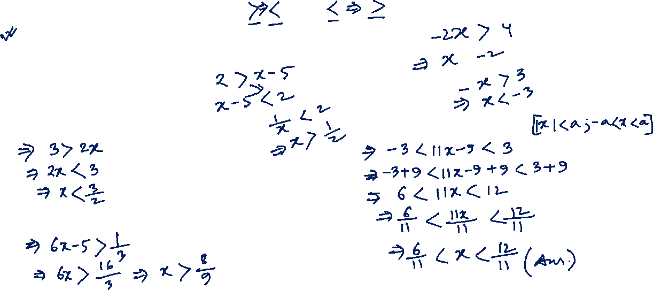
Inequality sign can be changed by:
Dividing/multiplying both sides by (-) negative numbers.
Exchanging the sides.
Inversing both sides.
1. Solve 3 – 2x > 0
2. Solve | 11x – 9 | < 3
3. Solve $\frac{1}{6x−5}$ < 3

Slide 7

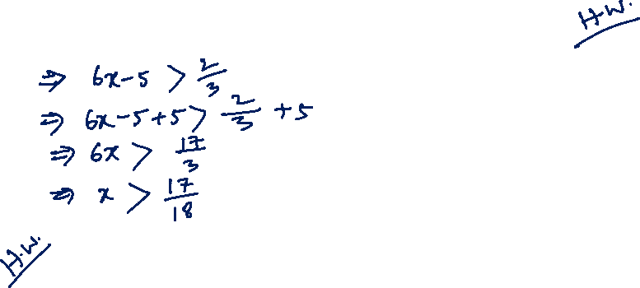
1. Solve $\frac{1}{6x−5}$ < $\frac{3}{2}$
2. Solve | 11x – 40 | ≥ 3
3. Solve 2x + 3 > $\frac{6}{5}$

Slide 8
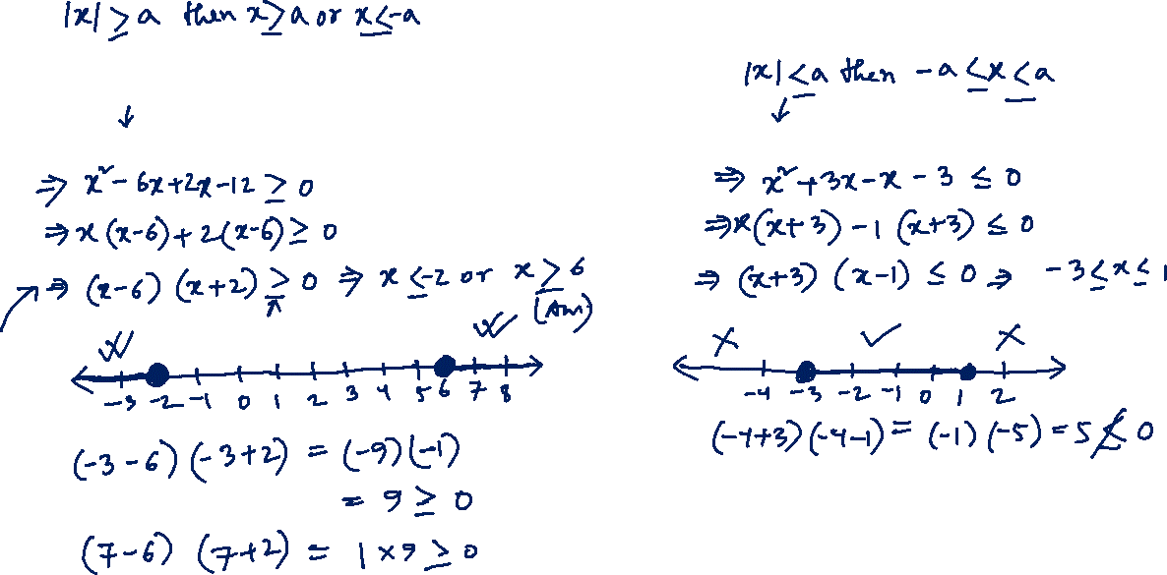
Quadratic Inequality
• Solve: x² – 4x – 12 ≥ 0
• Solve: x² + 2x - 3 ≤ 0

Slide 9
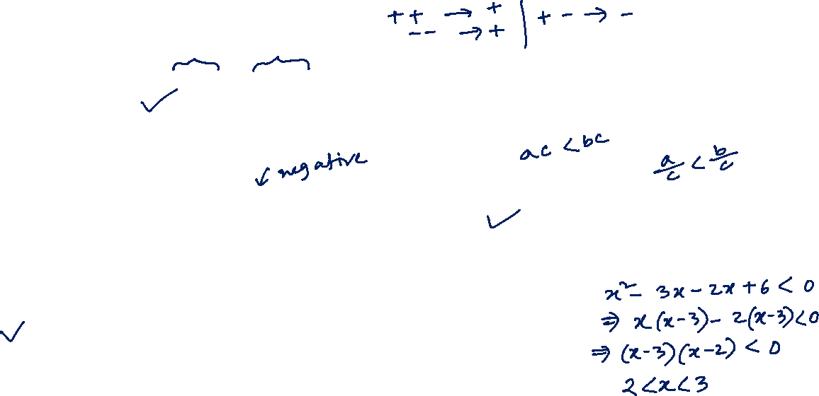
Practice Problem: If x > y and xy < 0 then which one of the following is negative?
a. x b. y c. both d. none
Practice Problem: If a > b and c < 0 then which one of the following is true?
a. ac > bc b. $\frac{a}{c}>\frac{b}{c}$ c. $\frac{c}{a}>\frac{c}{b}$ d. ac < bc
Practice Problem: Solve the inequality: x² – 5x + 6 < 0
a. 2<x<3 b. x>3 c. x<2 d. none

Slide 10
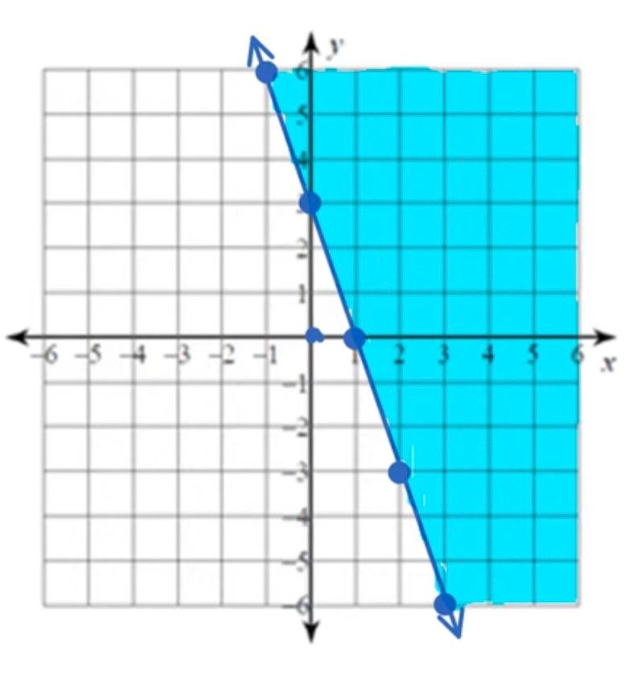
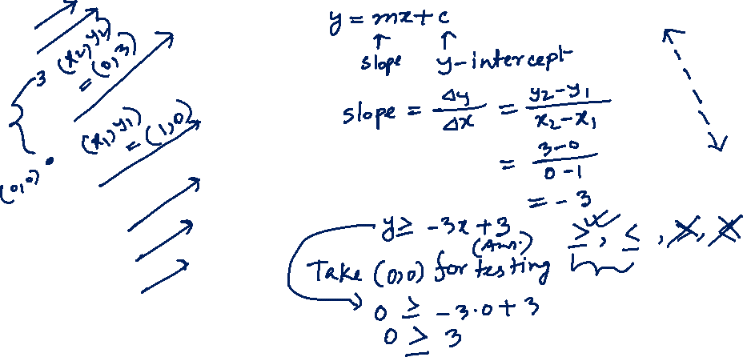
Linear Inequality Graph
Dotted line < or >
Solid line ≤ or ≥

Slide 11
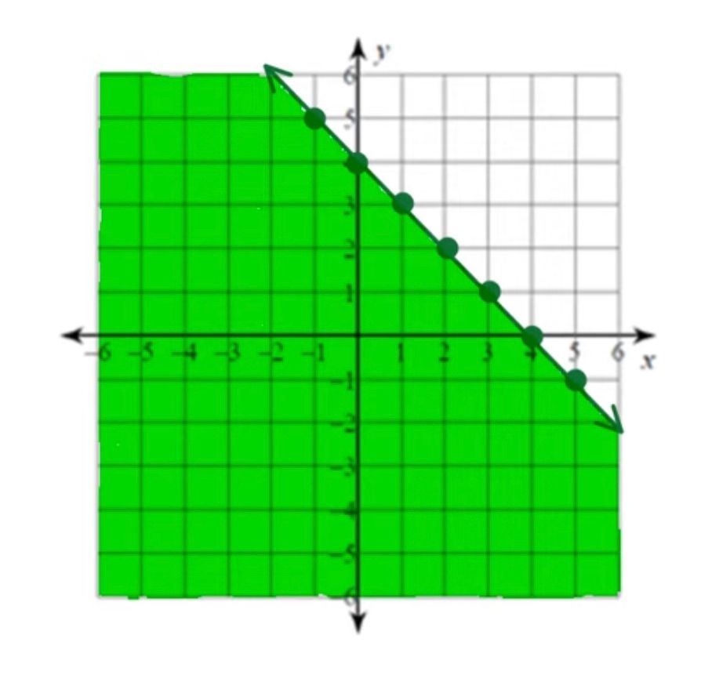
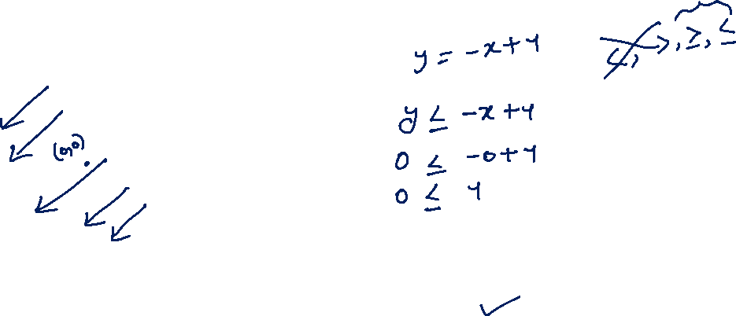
Practice Problem: Which one of following equation satisfy the graph?
a. y > -x + 4 b. y < -x + 4 c. y ≥ -x + 4 d. y ≤ -x + 4

Slide 12
Any Question?

Slide 13
Thank you for joining.

